Slide 1
DATA INTEGRATION
STEP 2 - INTEGRATION
Edbert Faustine, Ezzedine Ben Hadj Yahya , Xin Li

Slide 2
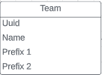
Teams
A list of all current nba teams
Assigned a unique identifier to each team
Example:
Uuid: e1e062f2-3e54-4c23-b0b9-780fcd94c81b
Name: Boston Celtics
Prefix 1: bos
Prefix 2: boston-celtics

Slide 3
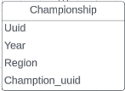
Championships
Start: Championships final with scores
Levenshtein distance to get the team unique identifier
Example:
Uuid: 6522732f-719f-4d5c-a854-d5f33dbe56cf
Year: 1962
Region: western
Champion_uuid (Foreign key): c925e241-1d7f-4a3e-af49-f1e47b928532

Slide 4

Players
Start: Players stats dataset.
Checked if there are duplicates in names.
We extracted all players we have in a separate dataset.
Assigned a unique identifier to each player.
Example:
Uuid: 552db664-eb14-48e9-9e55-4d113aba5185
Player name: Jaylen Adams

Slide 5
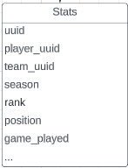
Players stats
Start: 4 datasets of the last 4 seasons.
Damerau Levenshtein distance to get players and teams uuid.
Dropped player names and team names.
Merged the 4 datasets and added season as attribute.
Example:
Uuid: b1f42f58-ff39-4118-9a4a-aef9b16113e3
Player uuid: de672850-f0fe-408d-af83-bc980af289b2
Team_uuid: 7a99a238-d8c6-4149-820f-c6c15c3549e1
Rank: 1
Position: G
GP: 3
…

Slide 6
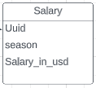
Players salaries
Start: 4 datasets of last 4 seasons.
Again Damerau Levenshtein distance to get players uuid.
Cleaned the salary attribute.
Merged the 4 datasets and and added season.

Slide 7
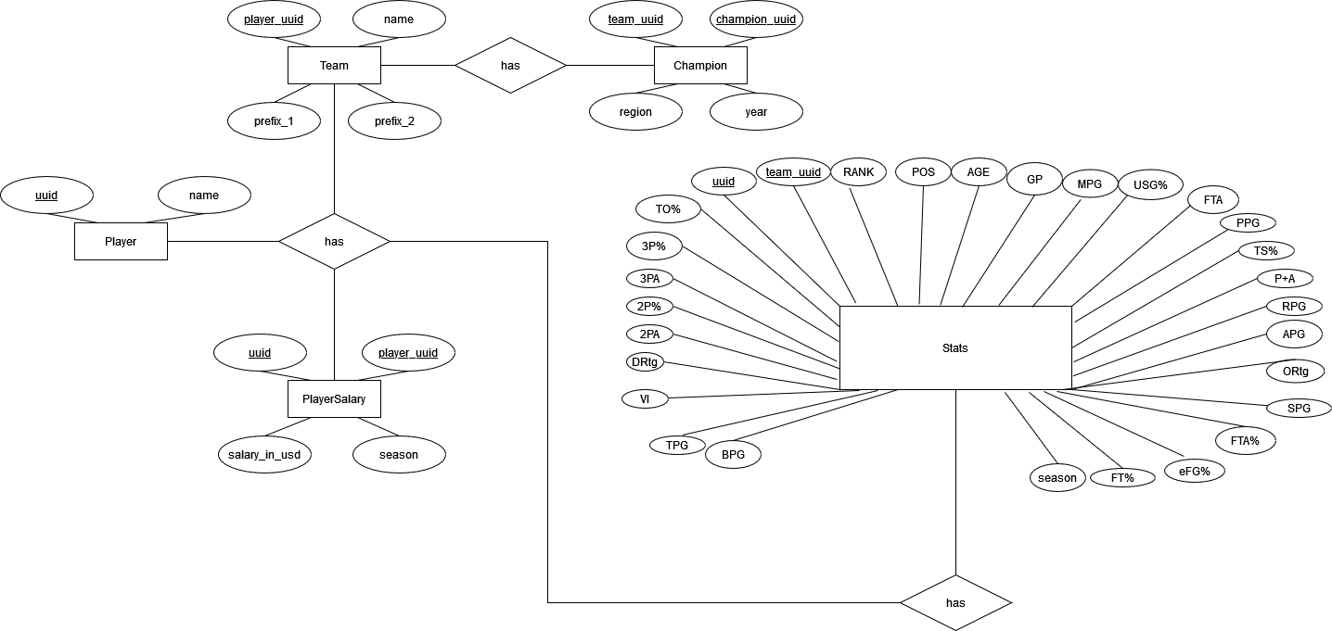
ERM

Slide 8
Next steps
Clean the data (look for different data samples, empty values…)
Create a SQL database.

